Slide 1
Michael Allen Sprint #1 Review
End of Sprint Survey, Biases, and Data Formats

Slide 2
Game Plan
1. Create Version 1.0 "End of Sprint Survey" in Survey Monkey
2. Investigate and Document Potential Bias for Survey Data
3. Analyze Output in SurveyMonkey
4. Export SurveyMonkey Data to Excel
5. Convert Excel Categorical Data to Numerical Data
6. Convert Excel to R
7. Look at Survey Data in CSV, illustrate and Annotate
8. Look at Survey Data in R, illustrate and Annotate
9. Create CSV Mind Mapping Concepts
10. Create R Mind Mapping Concepts

Slide 3
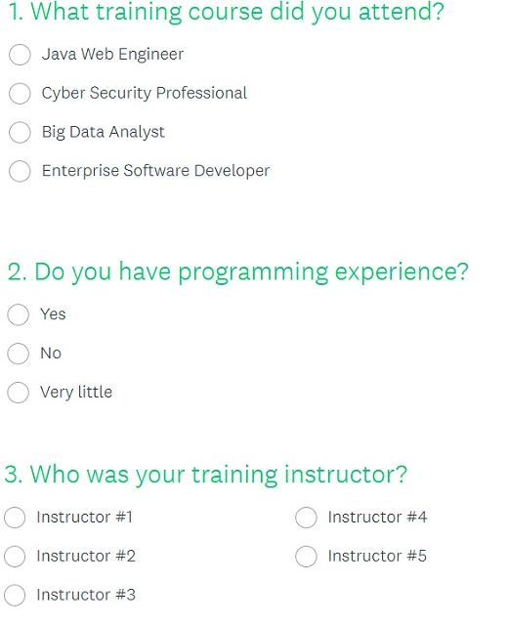
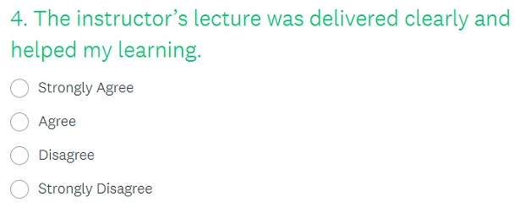
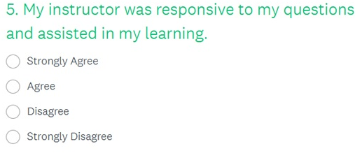
End of Sprint Survey

Slide 4
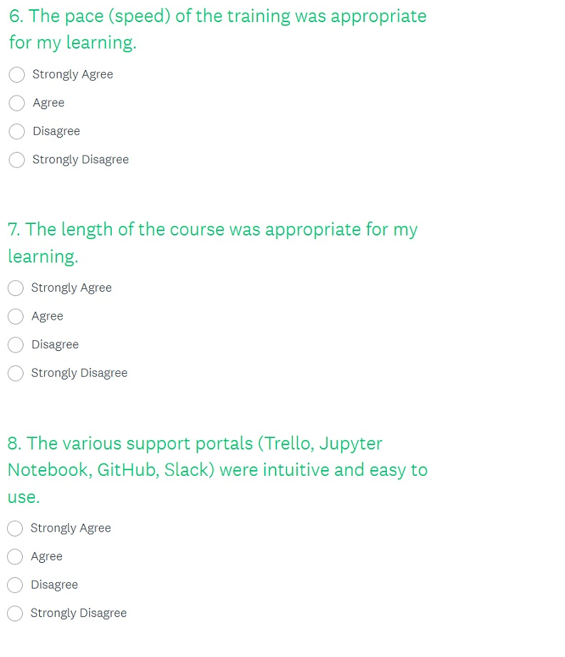
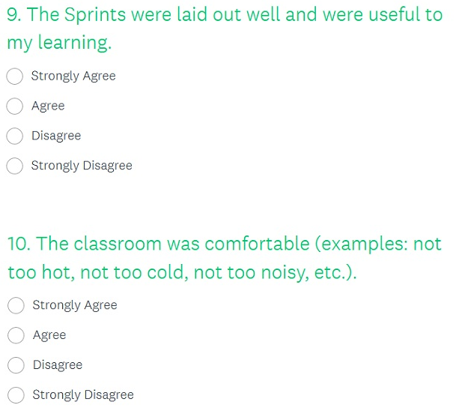
End of Sprint Survey II

Slide 5
Investigate and Document Potential Bias for Survey Data
Knowledgeable Enough to be Attending
Experience / Age / Gender
In a Rush to Complete Survey (Not Built-in Class Time to Complete)
Had a Bad Morning at Home / Hotel that Day
Bad Traffic Day
Not Focused During the Course
Did Not Do the Required Work Throughout the Course
Relationship Issues at Home / Work
Past / Present Working / Personal Relationship with Instructor
Motivation or Lack Thereof / Forced to Attend
Job Depends on Success of Course Understanding and Completion

Slide 6
Investigate and Document Potential Bias for Survey Data II
Response bias refers to the bias that results from problems in the measurement process.
Leading questions. The wording of the question may be loaded in some way to unduly favor one response over another.
For example, a satisfaction survey may ask the respondent to indicate where she is satisfied, dissatisfied, or very dissatisfied.
By giving the respondent one response option to express satisfaction and two response options to express dissatisfaction, this survey question is biased toward getting a dissatisfied response.
The order you ask questions matters. Mentioning products, brands, or events can affect how people rate their familiarity and attitudes on subsequent questions.
This can be especially harmful in branding and awareness surveys as the mere exposure of a brand name first can influence later questions and findings.
Response options also matter. A respondent might remember a choice that appeared in an earlier question and be more likely to select the response on later questions.
You can often manage many order effects through properly sequenced questions and randomization.

Slide 7
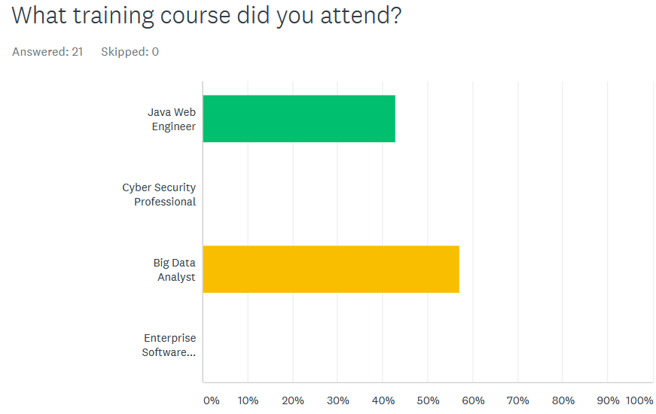
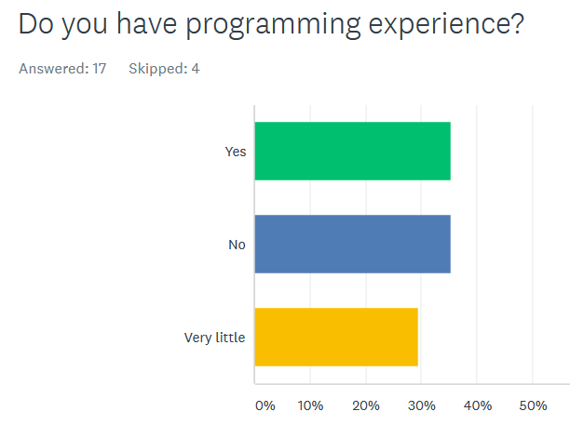
Analyze Output in Survey Monkey

Slide 8
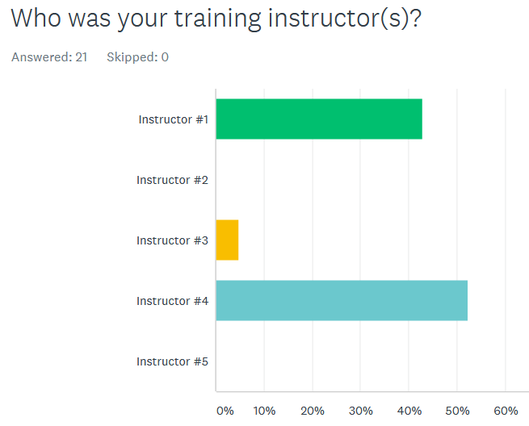
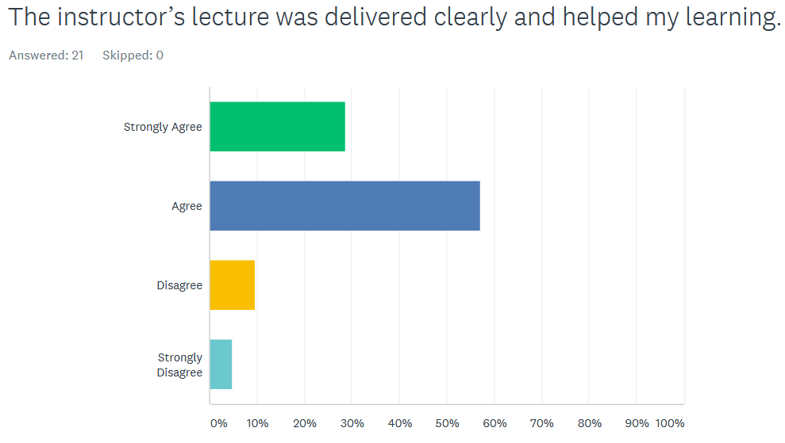
Analyze Output in Survey Monkey II

Slide 9
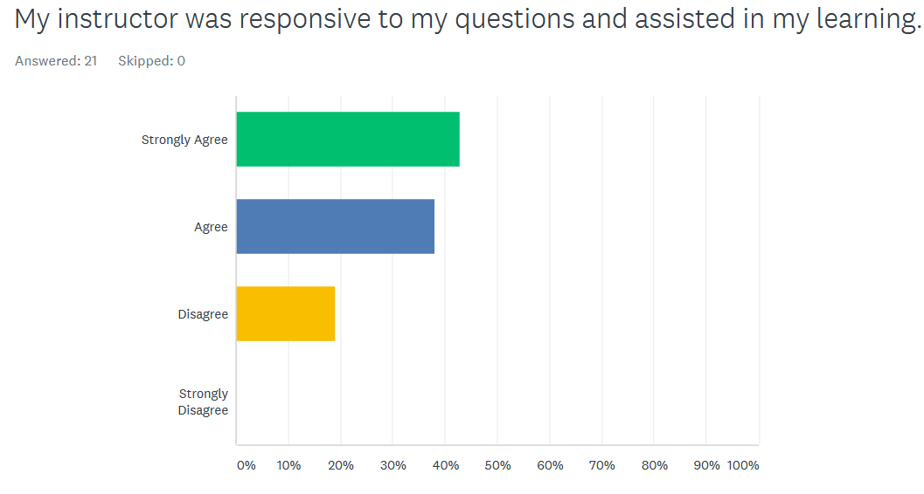
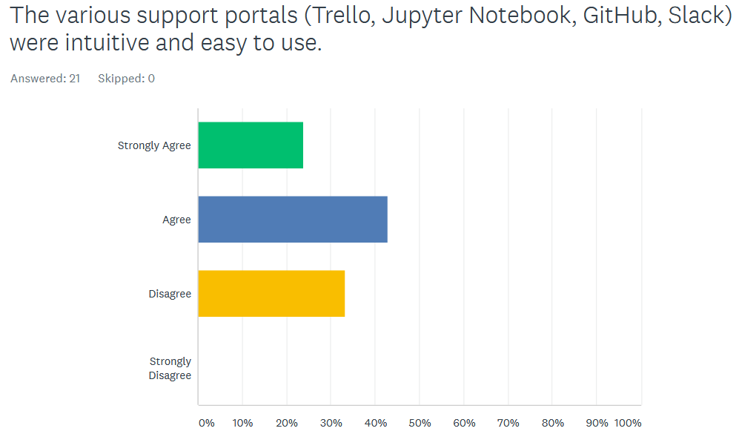
Analyze Output in Survey Monkey III

Slide 10
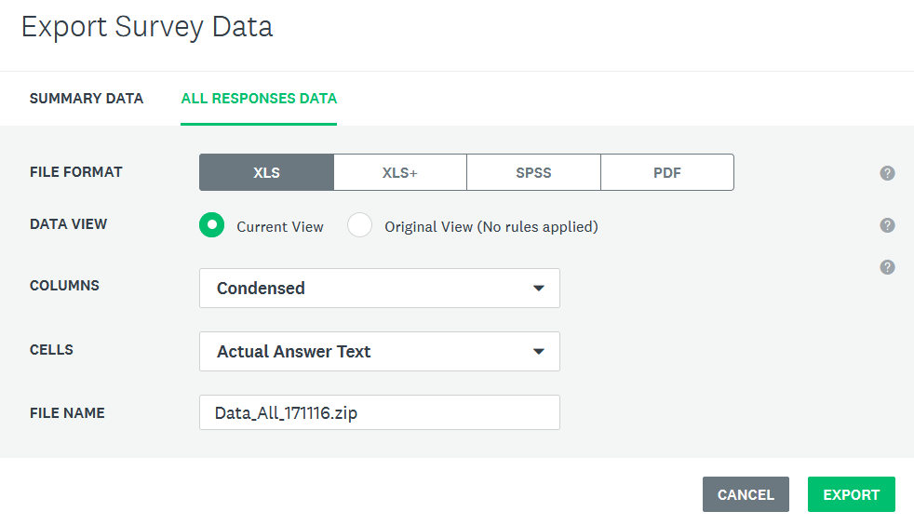
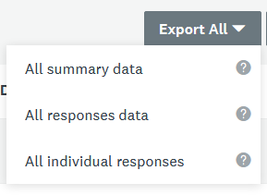
Exported End of Sprint Survey Data to Excel

Slide 11
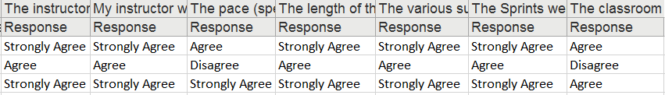
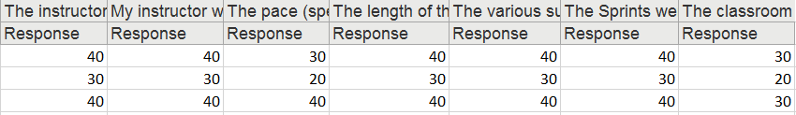
Replaced Excel Categorical Data to Numerical Data
Strongly Agree = 40
Agree = 30
Disagree = 20
Strongly Disagree = 10

Slide 12
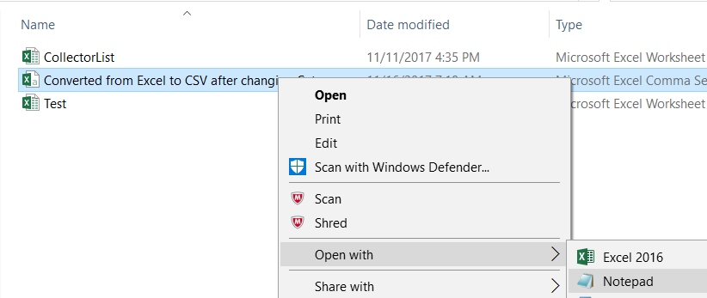
Opened and Saved Converted Excel Data to a CSV file

Slide 13
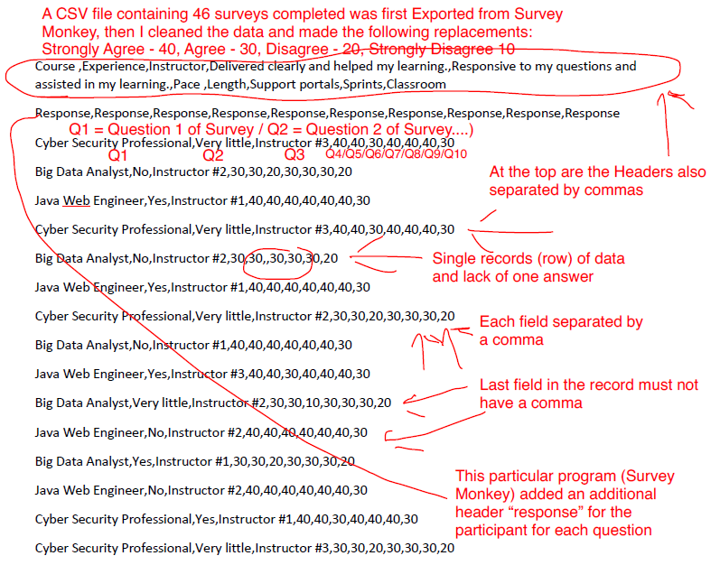
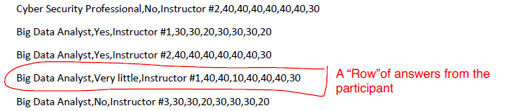
Annotated CSV file

Slide 14
Determined Working Directory and Read CSV file in R
getwd()
[1] "C:/Users/micha/Documents"
setwd("C:/Users/micha/Desktop/DevLeague Begins Nov 7 2017/")
> getwd()
[1] "C:/Users/micha/Desktop/DevLeague Begins Nov 7 2017“
read.csv("Simulated Survey Data II/CSV/Mock Survey Data.csv")

Slide 15
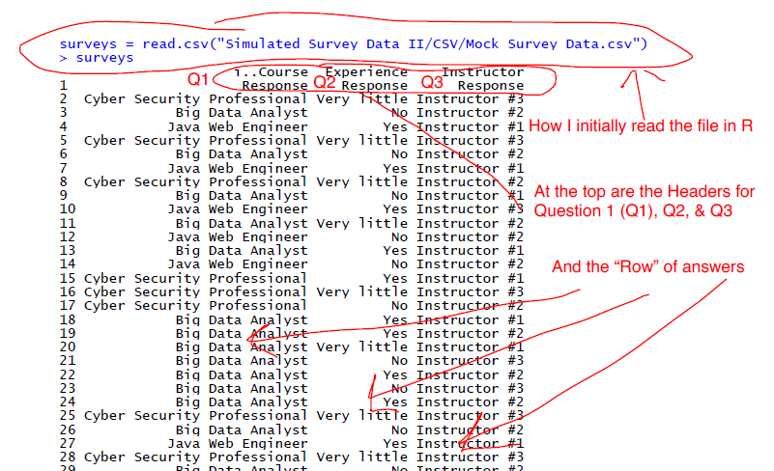
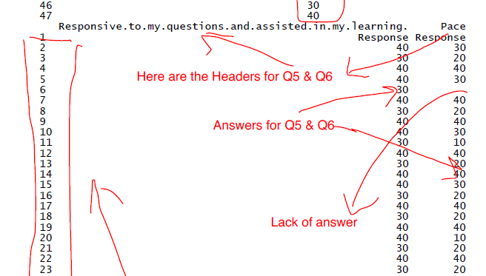
Annotated R File

Slide 16
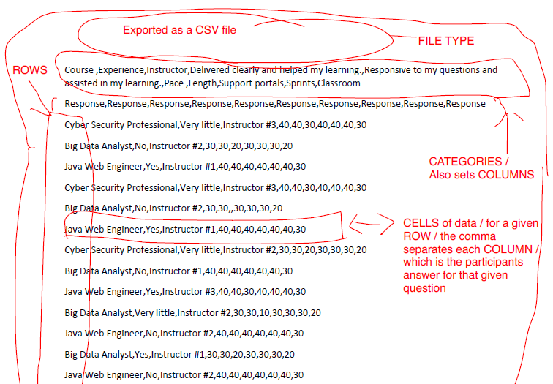
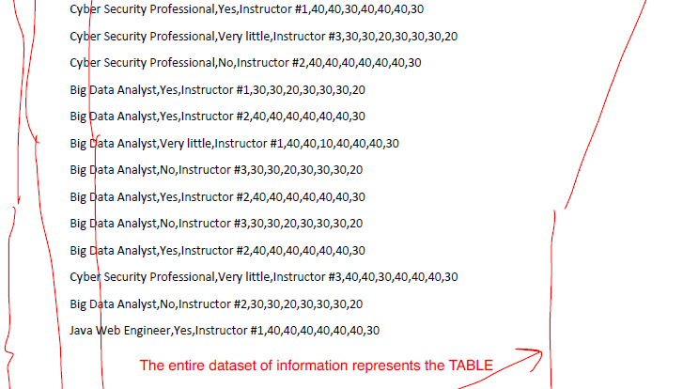
Created Mind Mapping for CSV File

Slide 17
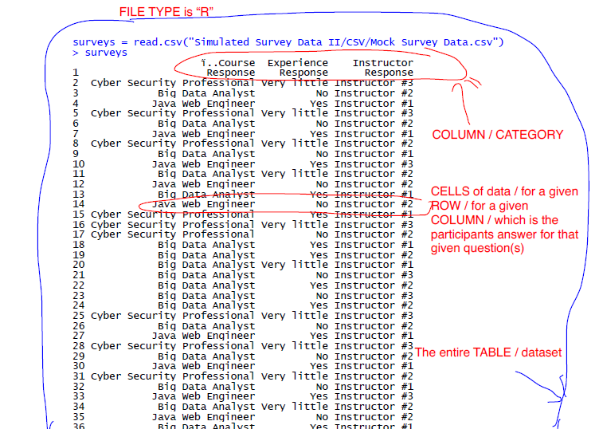
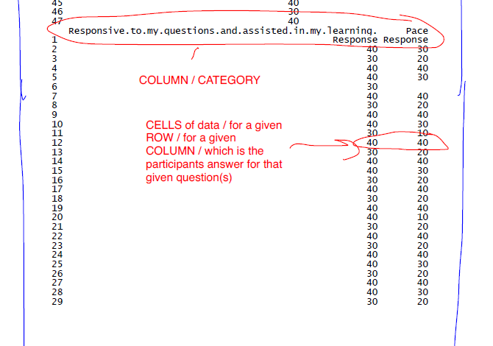
Created Mind Mapping for R File

Slide 18
Thank you

